Slide 1
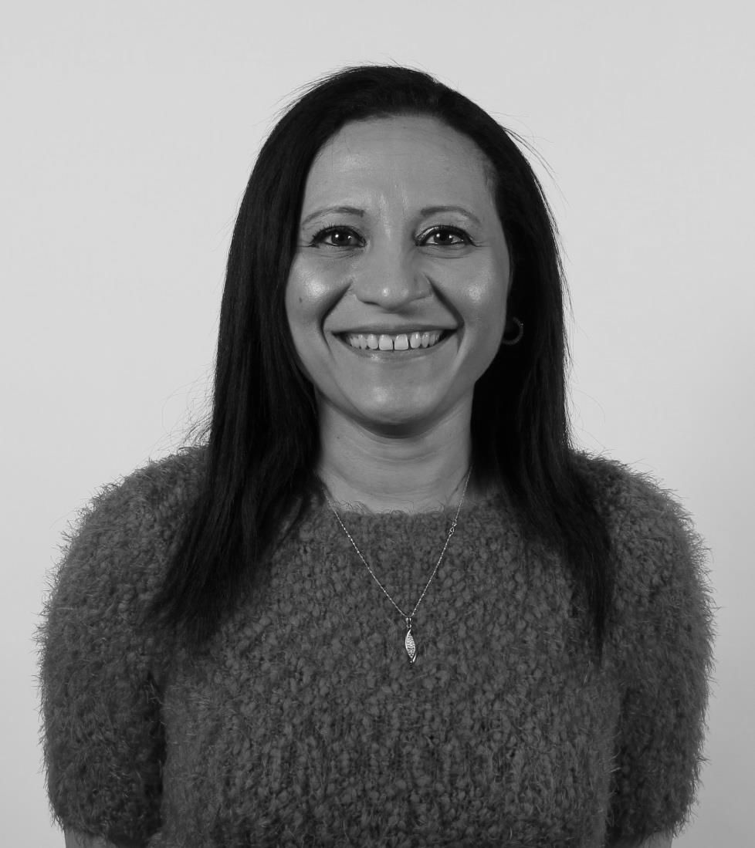
INTRODUCING…
DILSHAD SHEIKH CCMI
#CMIMIDLANDSCONF

Slide 2
DIVERSITY IN LEADERSHIP: MY PERSONAL STORY
Dilshad Sheikh CCMI
#CMIMIDLANDSCONF

Slide 3
Born in Nairobi
Classify myself as British Asian Female
Religion – Islam
A mixture of traditional Eastern and modern Western values and beliefs
Raised in Birmingham
Who am I?
Father
(½ Arab + ½ African), Mother (Indian)
Youngest of 7 children
Studied
In France
#CMIMIDLANDSCONF

Slide 4
MY PROFESSIONAL JOURNEY…
In 2015, was appointed as the Dean of the Business School (UCB)
Moved into teaching in 2000 and joined University College Birmingham
Appointed to different roles in various multinational organisations
Graduate Management Trainee
#CMIMIDLANDSCONF

Slide 5
HOW HAVE I FELT?
Had to work much harder
Pressure to “get into” social circles and networks
Get Overlooked
Question my purpose
Pressure to “get into” social circles and network
#CMIMIDLANDSCONF

Slide 6
WITHIN MY ORGANISATION…
32%
1st
female Asian Dean to be appointed in the history of UCB (established in 1957)
of the academics in the Business school are BME (unconscious bias?)
74%
of the students in the Business School are BME
#CMIMIDLANDSCONF

Slide 7
CURRENT & FUTURE CHALLENGES
Measure
Effectiveness
Measure diversity & inclusion
Move away from the command and control model?
Organisational paradigm shift
Paradigm
Shift
#CMIMIDLANDSCONF

Slide 8
CURRENT & FUTURE CHALLENGES
Connected Leadership
Four leadership intelligences - emotional, social & political, cultural and inclusive
Need leaders who understand the benefits of diversity
Effective
Leadership
Stakeholders (internal & external) can no longer be treated as homogenous groups
Put in place role models
Stakeholder
Management
Stakeholders
Management
#CMIMIDLANDSCONF

Slide 9
Final thoughts.
#CMIMIDLANDSCONF

